Slide 1
UNIT III GREEDY AND DYNAMIC PROGRAMMING
Session – 16

Slide 2
Syllabus
Introduction - Greedy: Huffman Coding - Knapsack Problem - Minimum Spanning Tree (Kruskals Algorithm). Dynamic Programming: 0/1 Knapsack Problem - Travelling Salesman Problem – Multistage Graph- Forward path and backward path.

Slide 3
Introduction
Greedy is a strategy that works well on optimization problems
Characteristics:
Greedy-choice property: A global optimum can be arrived at by selecting a local optimum.
Optimal substructure: An optimal solution to the problem contains an optimal solution to subproblems.

Slide 4
Applications
Kruskal's algorithm for finding minimum spanning trees
Prim's algorithm for finding minimum spanning trees
Huffman coding Algorithm for finding optimum Huffman trees.

Slide 5
HUFFMAN ENCODING
Problem: Finding the minimum length bit string which can be used to encode a string of symbols.
Used for compressing data.
Uses a simple heap based priority queue.
Each leaf is labeled with a character and its frequency of occurrence.
Each internal node is labeled with the sum of the weights of the leaves in its subtree.
Huffman coding is a lossless data compression algorithm.

Slide 6
Huffman coding
1) Build a Huffman Tree from input characters.
2) Traverse the Huffman Tree and assign codes to characters.

Slide 7
Steps to build Huffman Tree
Input: Array of unique characters along with their frequency of occurrences
Output: Huffman Tree.
Steps
1. Create a leaf node for each unique character and build a min heap of all leaf nodes (Min Heap is used as a priority queue)
2. Extract two nodes with the minimum frequency from the min heap.
3. Create a new internal node with frequency equal to the sum of the two nodes frequencies. Make the first extracted node as its left child and the other extracted node as its right child. Add this node to the min heap.
4. Repeat steps#2 and #3 until the heap contains only one node. The remaining node is the root node and the tree is complete.

Slide 8
Constructing a Huffman tree
A greedy algorithm that constructs an optimal prefix code called a Huffman code.
The algorithm builds the tree T corresponding to the optimal code in a bottom-up manner.
It begins with a set of |c| leaves and perform |c|-1 "merging" operations to create the final tree.

Slide 9
Algorithm for Huffman Coding
Data Structure used: Priority queue = Q
Huffman (c)
n = |c|
Q = c
for i =1 to n-1
do z = Allocate-Node ()
x = left[z] = EXTRACT_MIN(Q)
y = right[z] = EXTRACT_MIN(Q)
f[z] = f[x] + f[y]
INSERT (Q, z)
return EXTRACT_MIN(Q)

Slide 10

Example
Suppose we have a data consists of 100,000 characters that we want to compress. The characters in the data occur with following frequencies.

Slide 11
Methods to solve
Fixed Length Coding
Variable length Coding

Slide 12
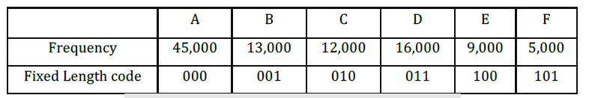
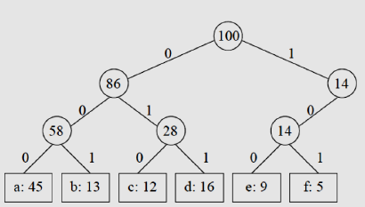
Fixed length coding
Fixed Length Code : In fixed length code, needs 3 bits to represent six(6) characters.
Total number of characters are
45,000 + 13,000 + 12,000 + 16,000 + 9,000 + 5,000 = 1000,000.
Add each character is assigned 3-bit codeword => 3 * 1000,000 = 3000,000 bits.

Slide 13
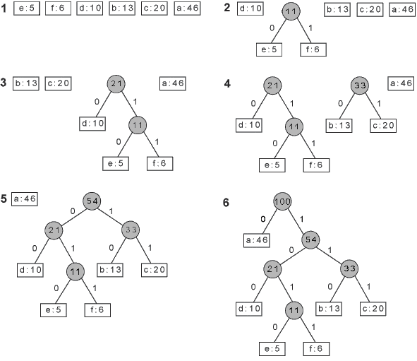

Slide 14
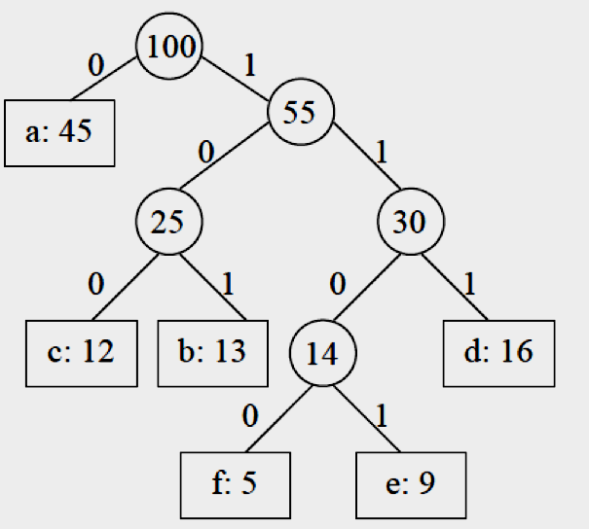
Variable Length coding
 | A | B | C | D | E | F
Frequency | 45000 | 13000 | 12000 | 16000 | 9000 | 5000
Fixed Length code | 000 | 001 | 010 | 011 | 100 | 101
Variable length code | 0 | 101 | 100 | 111 | 1101 | 1100

Slide 15
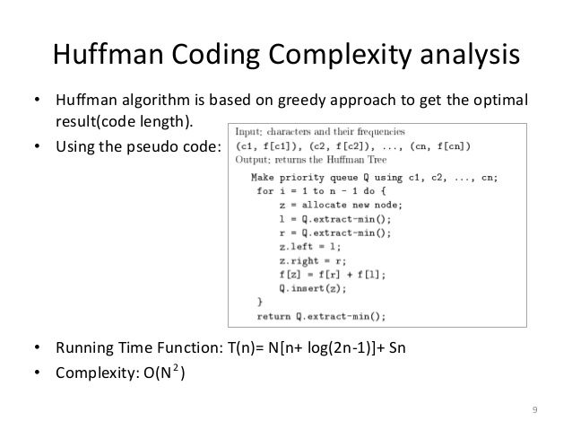
Complexity Analysis

Slide 16
Worksheet No. 16

